Slide 1
AI, SOCIAL MEDIA & MBS
Mirto Foletto, M.d.
Chirurgia bariatrica
Azienda Ospedale – Universita’ Padova

Slide 2

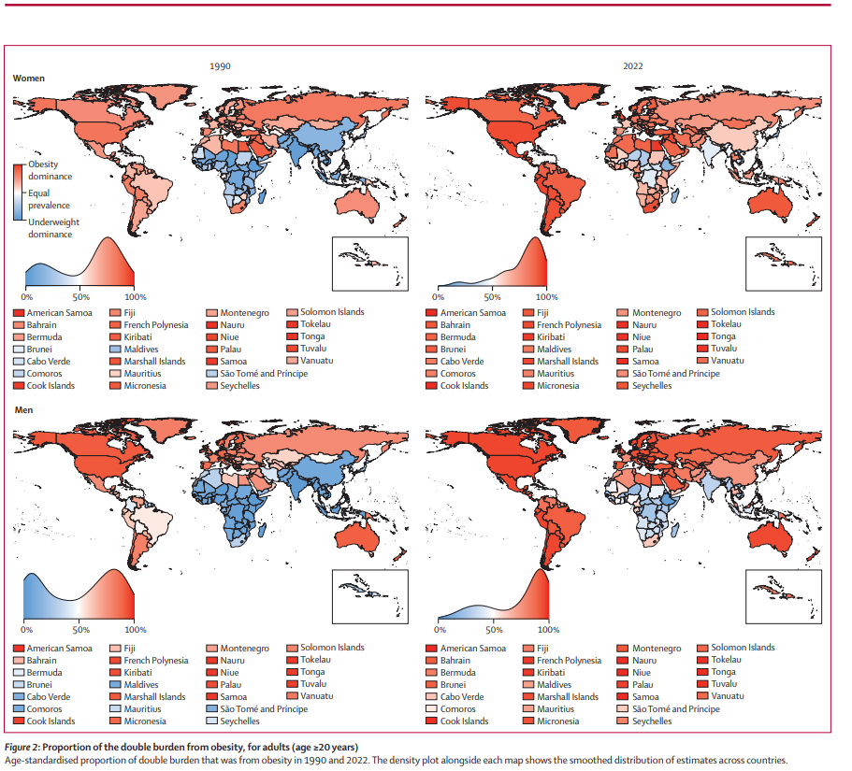
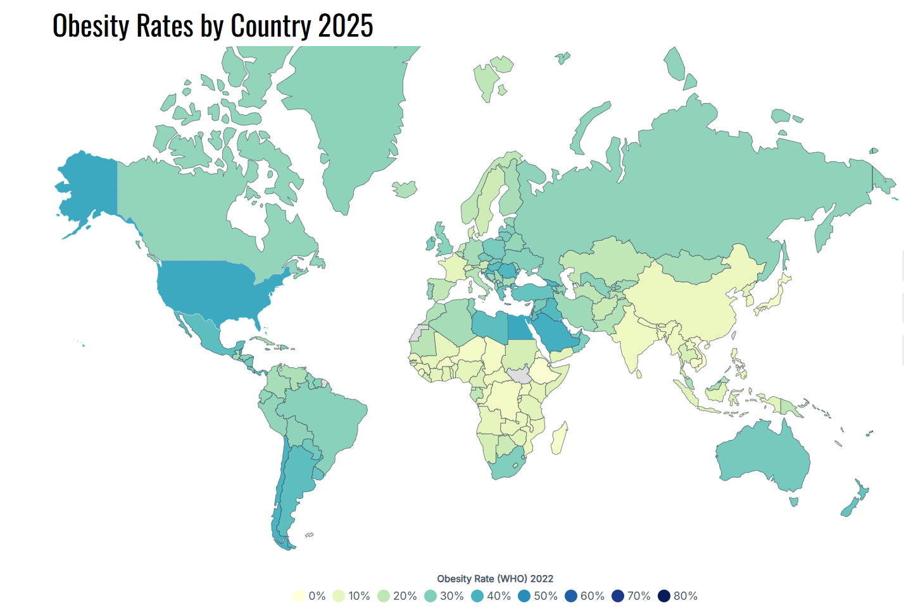
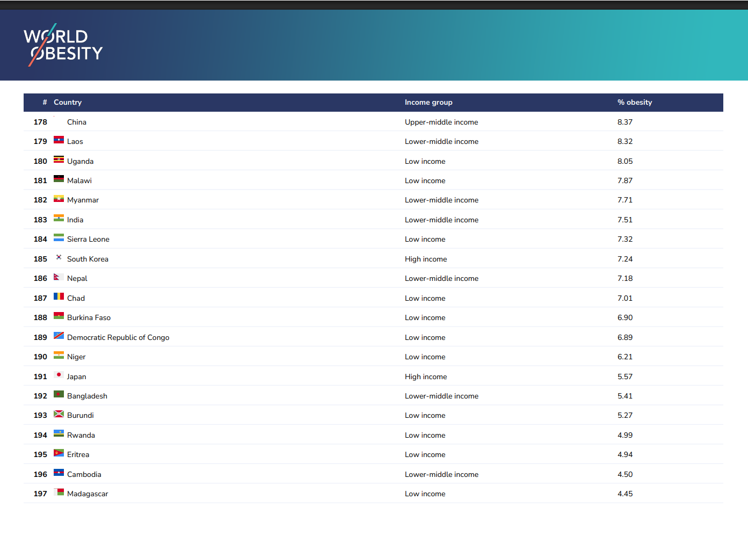
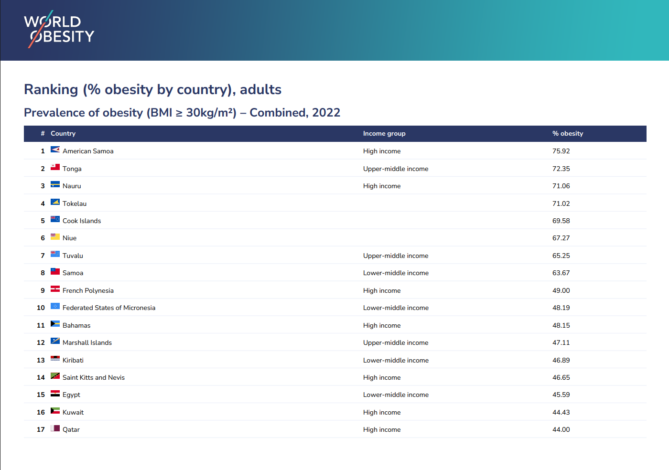
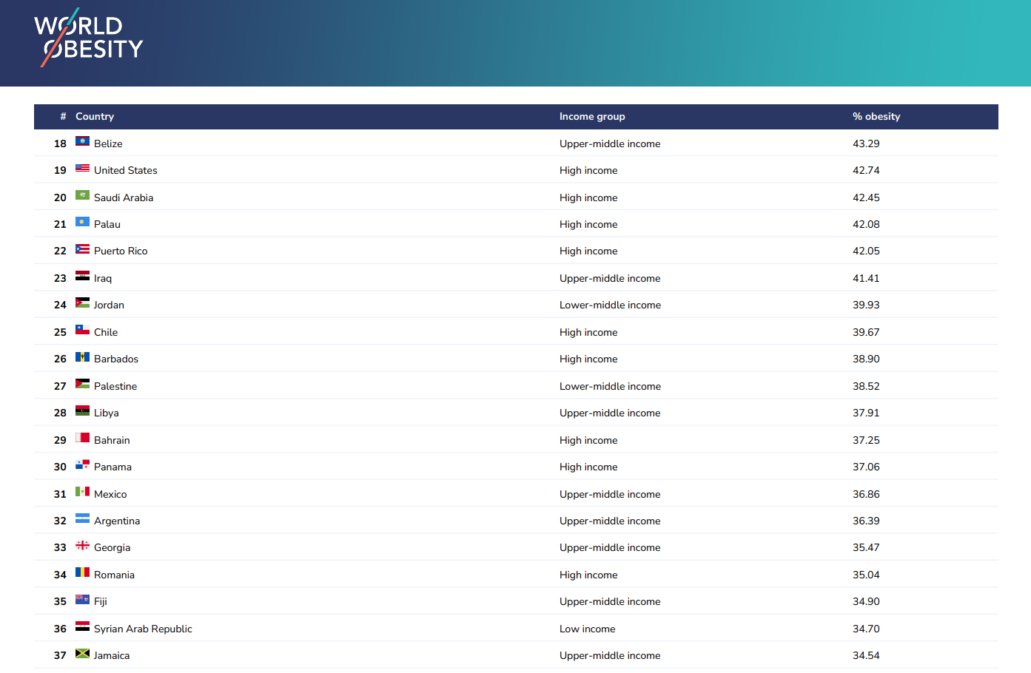
Obesity: chronic relapsing disease

Slide 3
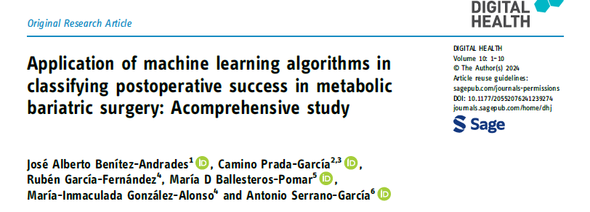
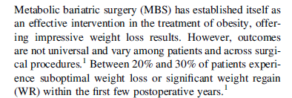

Slide 4




Slide 5

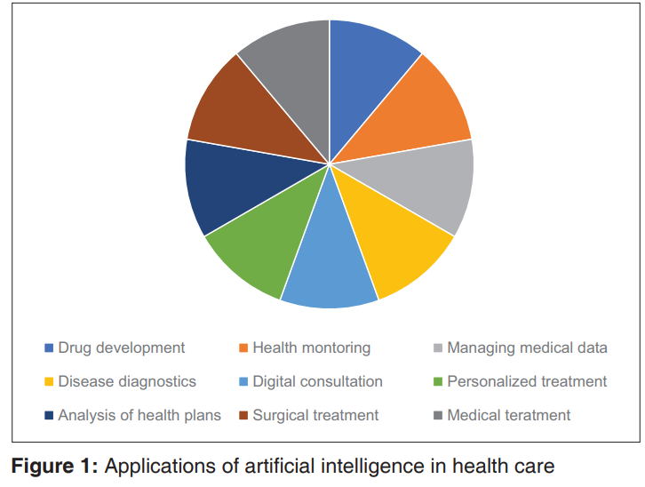
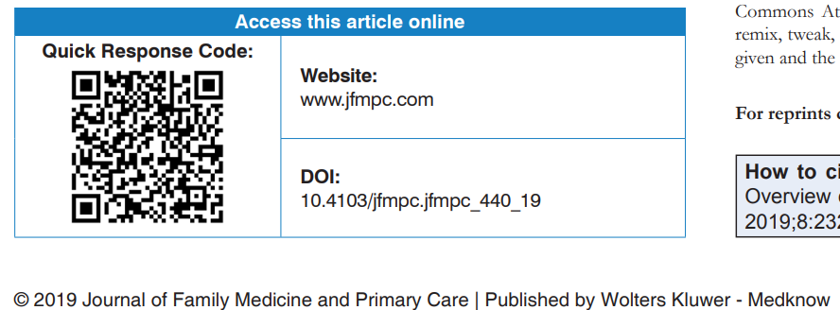

Slide 6

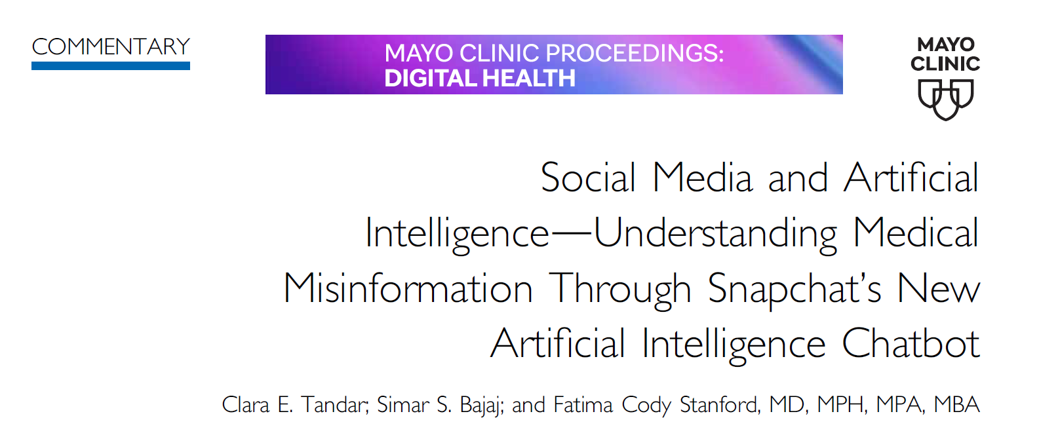

use. Despite this potential, the incorporation
of AI chatbots into social media platforms combined
with the breadth of social media use
across the population could also accelerate
the spread of poor health advice and misinformation.

Slide 7
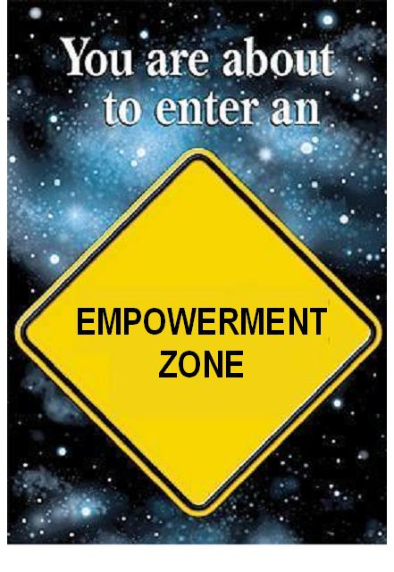
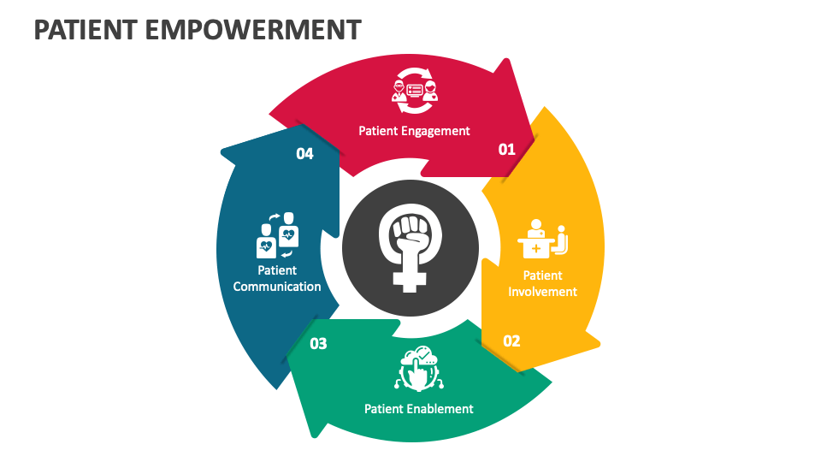
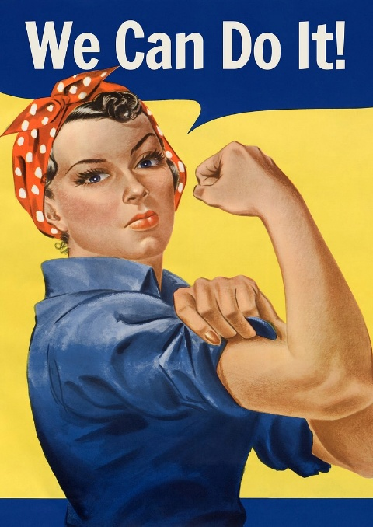

Slide 8
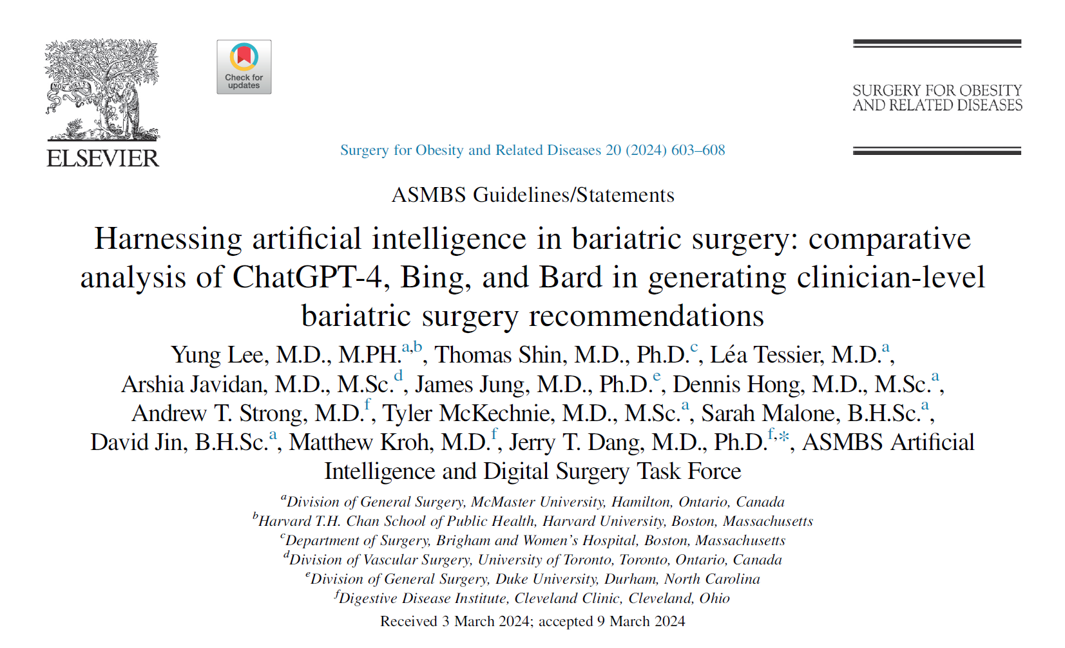
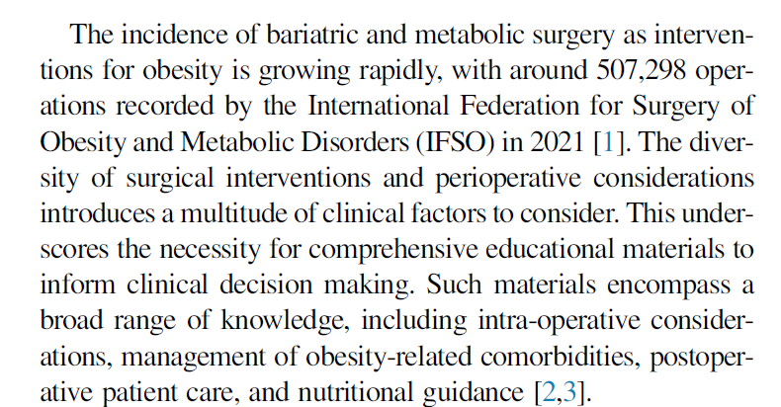


Slide 9

The issue: reliability of the chatbots outputs!

Slide 10
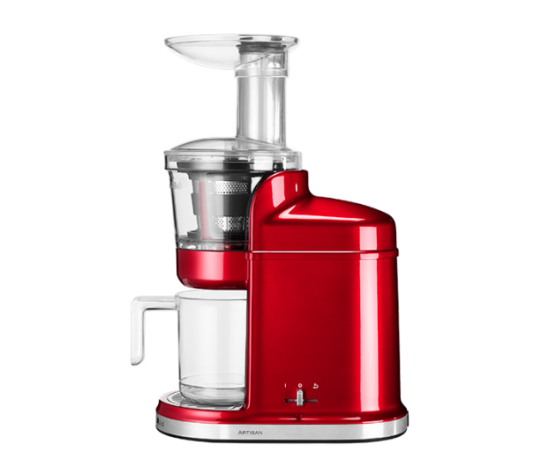

Big Data
Guidelines
Pts inquiries…
AI
Personalized medicine?

Slide 11


Slide 12
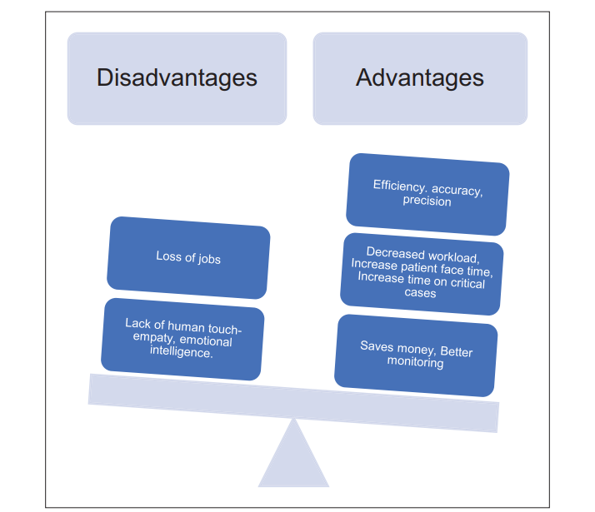

Slide 13
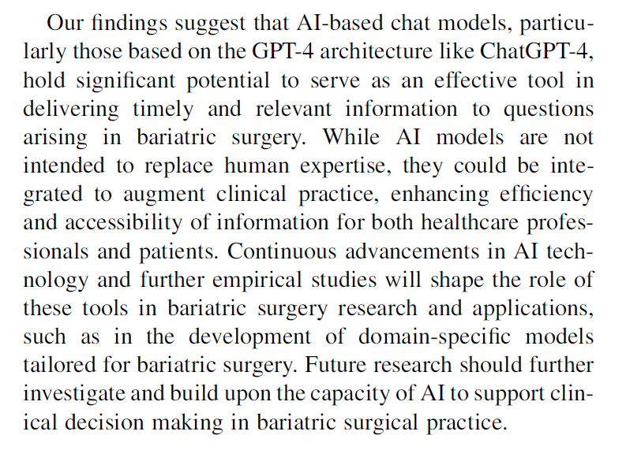
The issue: reliability of the chatbots outputs!

Slide 14



Key issues
Key issue
AI
Social Media
Multimodality treatments

Slide 15
Grazie
mirto.foletto@unipd.it

